Slide 1
Market Comparing App
Presented by
Emanuel Deckel

Slide 2
Features
Select items from a huge 25,000 product database, including over 100,000 different unique prices.
Manage your selected cart using “Add” and “Remove” buttons, with an option to specify item quantity.
Compare prices - across currently 3 different chains, including 4 different stores each.
Comprehendible output, easily noticing which store has the lowest price.
Semi-Automatic Database updating (currently takes too long).

Slide 3
Bonuses for work:
Creating and maintaining a Database using code first approach with Entity-Framework.
UI – using a WPF type application.
MVVM architectural approach.
A system to compare prices according to the provider’s city and parent chain.
Semi-Automatic updating of database, not functional due to unrealistic updating time.

Slide 4
Solution architecture
Start up project is a WPF application.
Project includes the View-Model layer for routed communication between app UI and app logic.
View model includes:
MainWindowViewModel class – containing all commands and ObservableCollections filled from database, and processed before passing to UI through data binding.
DelegateCommand - gives the commands functionality.
ObservableObject – gives the OnPropertyChange functionality.

Slide 5
Inheritance in view-model
MainViewModel inherits from ObservableObject to utilize the OnPropertyChange UI refresh.
DelegateCommand inherits from a costume interface- ICommandEx which adds a Header property to all commands.
ICommandEX inherits from the ICommand interface which is responsible for all DelegateCommands functionality (Execute and CanExecute methods).

Slide 6
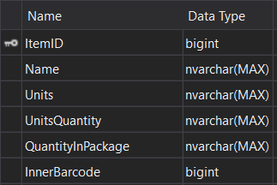

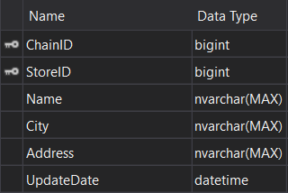
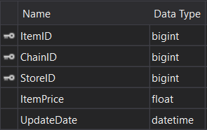
Database
Items
Chains
Stores
Prices

Slide 7
Cart Compare project
CartComparer class – used from the view-model command “CompareCommand” to compare chosen items across all stores and return a carts collection containing comparison information.
Cart comparer uses Cart object for storing information total price and other information about the item and store.
Cart comparer uses CartToCompare object to store temporary data, before creating a new Cart object.
The items are represented by a ItemInQuantity object that stores an Item Object (containing all item information) and the item quantity the user has chosen.

Slide 8
File Manager project
MarketXmlParser is used in the View-Model command “UpdateDatabaseCommand” to parse all XML files in a given folder. This class uses different methods for parsing the “AllPrices” XML and the “Stores” XML files that every chain provides the public.
FileExtractor is used by MarketXmlParser to automate extracting files from a GZ zip file and returning a list of all available files that contain the strings “AllPrices” and “Stores”.

Slide 9
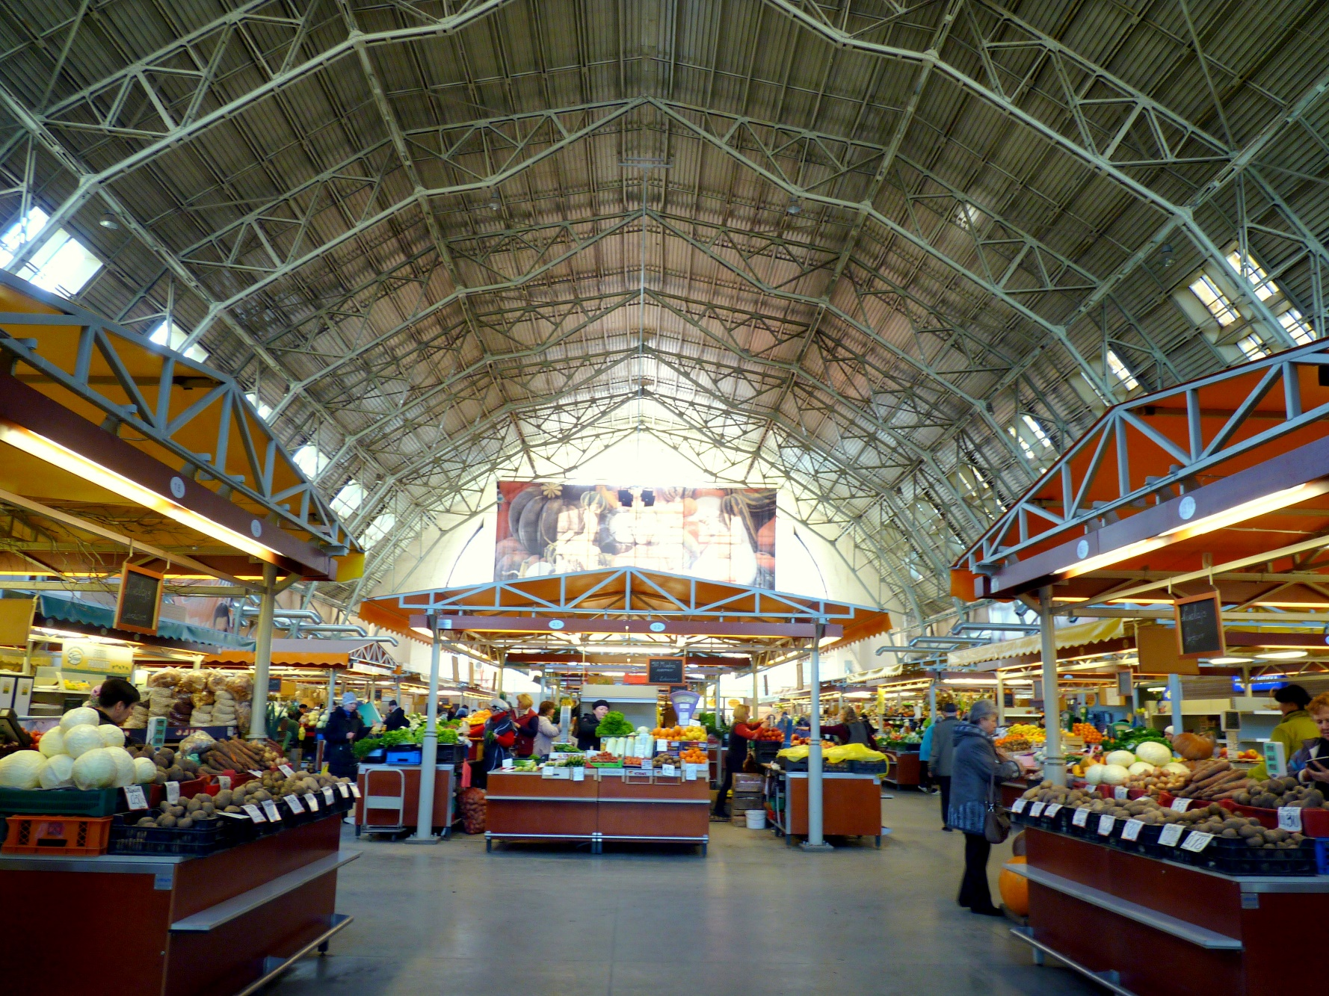
Thank you for listening !

